Slide 1
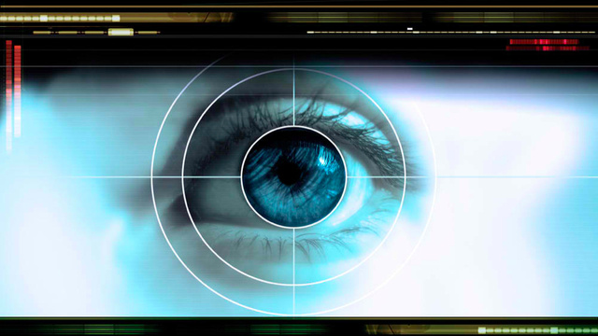
Human Perception (Part 2) (Johnson 4-6)
http://io9.gizmodo.com/5926643/10-fundamental-limits-to-human-perception----and-how-they-shape-your-world
Notes:
Artist Jackson Pollock

Slide 2
This Class is About How Human Perception and Reading Work (Johnson 4-6)
Agenda for Today’s Class
Possible solution to IA #3
Vending Machine Design
Our color vision is limited
Our peripheral vision is poor
Reading is unnatural
Introducing IA#4: Design Challenge

Slide 3
Cognitive walkthrough tasks
Create array
Populate array
Create maxsofar variable
Create array index
Specify loop
Compare maxsofar to current array item
Update maxsofar
Execute algorithm

Slide 4
Cognitive Walkthough: Possible Solution
Possible solution posted to “Solutions” area of IA#3
Your results may differ in the details!
I’ll briefly present my solution here.

Slide 5
This Class is About How Human Perception and Reading Work (Johnson 4-6)
Key topics/questions for Today’s Class
Possible solution to IA #3
Vending Machine Design
Our color vision is limited
Our peripheral vision is poor
Reading is unnatural
Introducing IA#4: Design Challenge

Slide 6
Design Task: Vending Machine
Design a vending machine that sells the following products (prices in parentheses below):
Users of the vending machine must be able to pay with cash or credit card. In the case of cash, any excess payment should be returned to the user (exact change is not required).
Sketch out some designs. Justify design choices using principles from today’s class (see next slide)
Thneads
Thnads
Thrugs
Thrads
Thuds
($1.25)
($1.50)
($1.75)
($1.00)
($2.25)
Thrids
Thacts
Thents
Thraves
Thags
($2.25)
($1.55)
($3.00)
($2.75)
($2.55)

Slide 7
Design principles to keep in mind
Avoid ambiguity
Be consistent
Understand users’ goals
Proximity
Similarity
Continuity
Closure
Symmetry
Figure/ground
Common fate
Visually structure info to match task

Slide 8
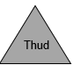
1. Make selection:
Thnead
Thnad
Thrug
Thrad
Thud
($1.25)
($1.50)
($1.75)
($1.00)
($2.25)
Thrid
Thact
Thent
Thrave
Thag
($2.25)
($1.55)
($3.00)
($2.75)
($2.55)
Selected:
Amount Due: $1.50
2. Make payment:
Cash
Credit
Coins
Bills
Insert card
Payment feedback displayed here
3. Pick up item:
Item dispensed here
Notes:
This is all in one screen. An alterative would be a wizard style that separated out each step.
Principles to discuss:
Avoid ambiguity
Be consistent
Understand users’ goals
Proximity
Similarity
Continuity
Closure
Symmetry
Figure/ground
Common fate
Visually structure info to match task

Slide 9
This Class is About How Human Perception and Reading Work (Johnson 4-6)
Key topics/questions for Today’s Class
Possible solution to IA #3
Vending Machine Design
Our color vision is limited
Our peripheral vision is poor
Reading is unnatural
Introducing IA#4: Design Challenge

Slide 10
Reading Question #1
Our vision is optimized to see
Color
Contrast
Both are equally optimized
Notes:
Contrast

Slide 11
Reading Question #2
Which of the following is used to help us see color?
Rods
Cones
Notes:
Cones

Slide 12
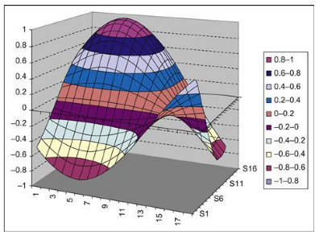
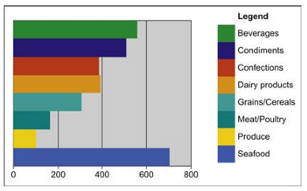
Reading Question #3: Which is better, and why?
A. B.

Slide 13


Reading Question #4: Is the highlighting color of item 2 a good choice? Why or why not?
Yes
No

Slide 14
Reading Question #5: People who are color blind can see colors
True
False

Slide 15
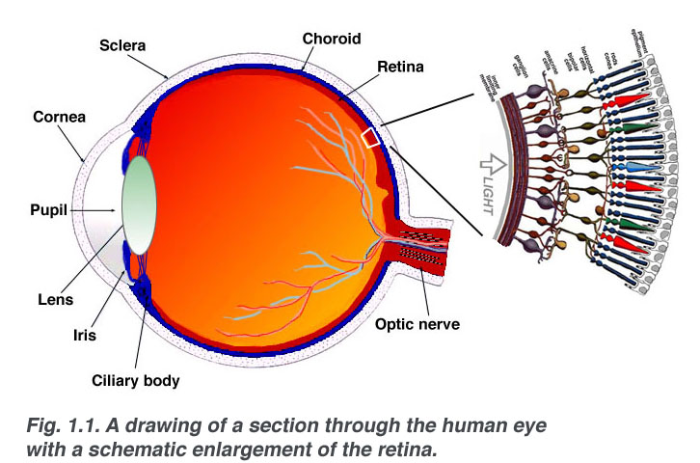
How does color vision work?
Rods and Cones
http://webvision.med.utah.edu/book/part-i-foundations/simple-anatomy-of-the-retina/
Notes:
Retina has two types of receptors: rods and cones. Rods detect light levels but not colors. Cones detect color. There are three types of cones, each sensitive to a different frequency of light. It used to be taught that each type of cone was sensitive to a frequencies of light that correspond to red, blue, and green, but we now know that that isn’t true.

Slide 16
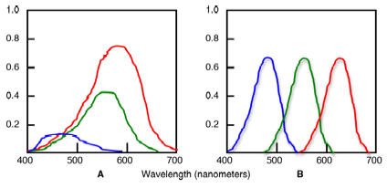
Our Color Vision is Limited
Our color vision is based on differences
Notes:
Low frequency cones (red line in A): most sensitive overall, but best at yellows and reds
Medium frequency cones (green line in A): less sensitive than low frequency cones; best at blues, yellows, and oranges
High frequency cones (blue line in A): least sensitive cones overall, and least numerous; best at violets and blues
Contrast this reality with the “ideal” distribution of cone sensitivity on the right (figure B). This rivals the sensitivity of a camera.

Slide 17
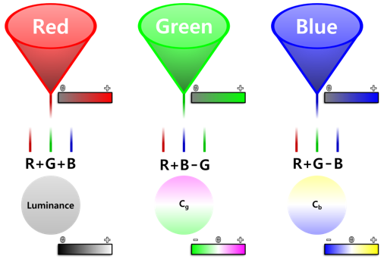
How does brain combine cones to allow us to see color?
By Subtraction!
Red-green difference signal channel computes difference in signals from medium- low-frequency cones
Yellow-blue difference signal channel subtracts signals from high and low-frequency cones
Luminance (black-white) signal channel adds signals from low- and medium-frequency cones
Nearby signals from these channels are subtracted to produce color vision
https://en.wikipedia.org/wiki/Color_vision

Slide 18

Punchline: Vision optimized to see contrasts
We are good at seeing contrasts—edges & changes—but not absolute levels
(Clicker) Is the inner bar the same color throughout? A. Yes B. No
Notes:
Here is an Illustration of this. Our visual sensitivity to contrast served us well from an evolutionary perspective. It allowed us to see potentially dangerous predators at any time day or night.

Slide 19
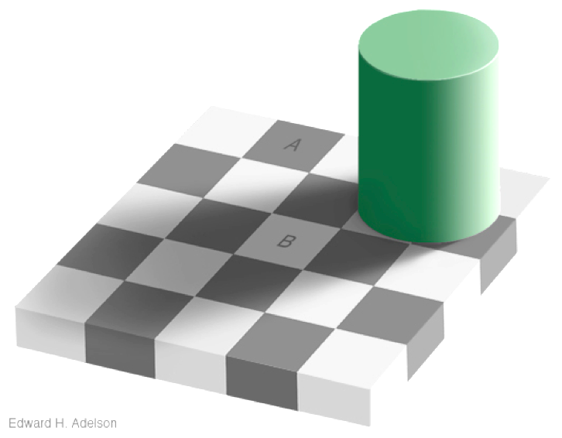
Vision optimized to see contrast
Squares A and B are the same shade.
A. True B. False
A:
B:
Notes:
Developed by Edward Adelson at MIT. They look like different shades because square B is shaded from the cylinder’s shadow

Slide 20
Our ability to discriminate colors depends on their presentation
The paler the colors are, the harder it is to tell them apart
The smaller the color patches, the harder it is for us to distinguish between them
The more separated the patches are, the harder it is for us to distinguish between them
Notes:
All: Harder

Slide 21
“Color-blindness” is a limiting factor
People who are color blind can see colors!
They just have trouble distinguishing certain pairs of colors
one or more color subtraction channels are not working normally
8% of men, 0.5% of women have this issue

Slide 22
Red-green colorblindness is most common
Colors that would be hard for red-green colorblind people to distinguish:
Dark red from black
Blue from purple
Light green from white
To test a design, put it through a color-blindness filter
Notes:
Dark red (brown) and black
Blue and purple

Slide 23
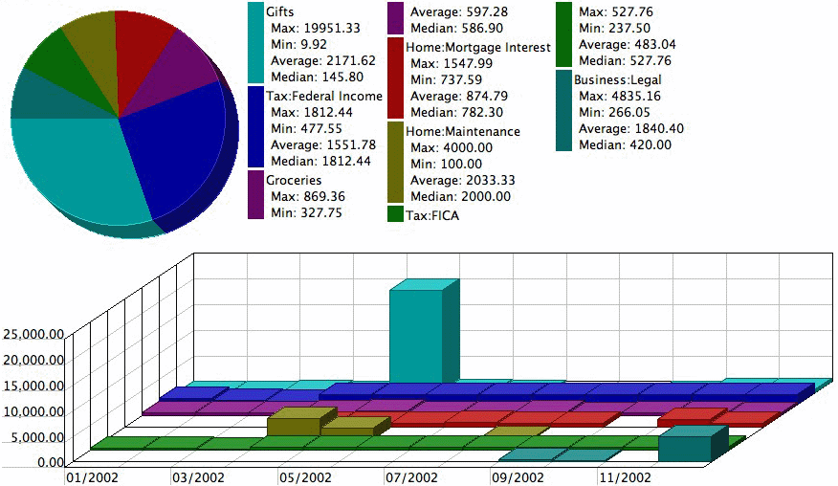
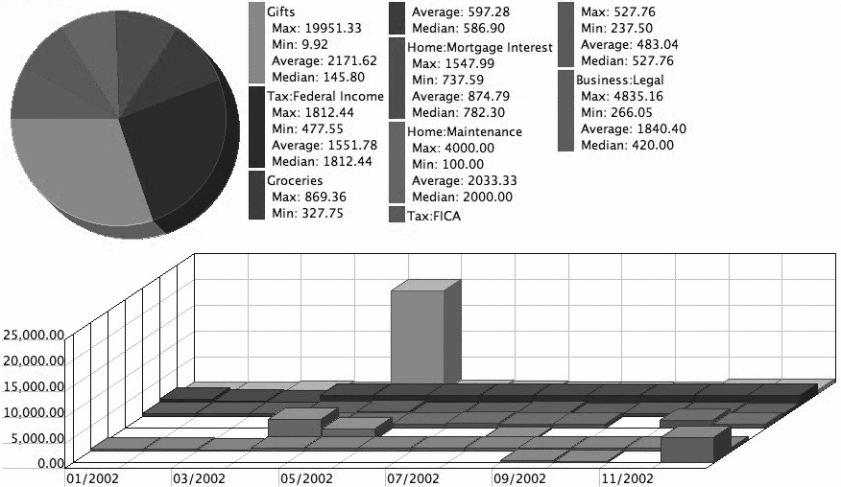
Use B&W rendering to obtain an approximation of readability by colorblind individuals
MoneyDance rendered in B&W
Notes:
The software product MoneyDance graphs home finance-categories using colors
that color-blind people may not be able to distinquish.
We can get a sense of that by rendering the image in B&W.

Slide 24
Keep in mind that you do not have complete control over color
Colors may appear different on different displays, which vary by make, model, driver software, display settings
Many colors look the same on gray scale displays
Viewing angle can influence colors
Colors may be washed out by ambient light
→ What you see might not be what users see

Slide 25

Design implication: Don’t rely solely on color
Use redundantly with other cues
E.g., Let’s improve ITN.net

Slide 26
Design implication: Use more distinctive colors
Most distinctive colors:
Other distinctive colors:

Slide 27
This Class is About How Human Perception and Reading Work (Johnson 4-6)
Key topics/questions for Today’s Class
Our color vision is limited
Our peripheral vision is poor
Reading is unnatural
IA#3: Apply what you have learned to a design challenge

Slide 28
Reading Question #6: Why is vision better within foveal field?
Data within foveal field is uncompressed
Cone density is higher within foveal field
More processing power dedicated to fovea
A, B, & C
Notes:
D

Slide 29
Reading Question #7: What is peripheral vision good at?
Viewing color
Viewing motion
Low-light conditions
A & B
A, B, & C
Notes:
E

Slide 30
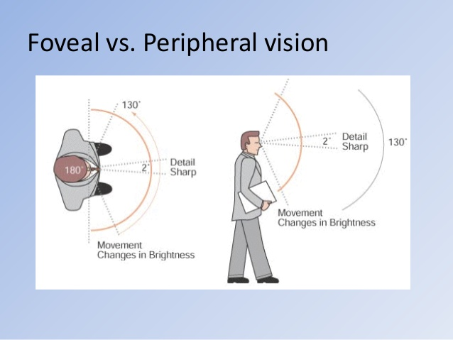
Spatial resolution of human vision is best within foveal field
Notes:
Our vision remains sharp only within a 2 degree visual field. To visualize that field, hold your thumb out at arm’s length and focus on your thumbnail. That focal point corresponds to your fovea; everything else is in periphery.

Slide 31
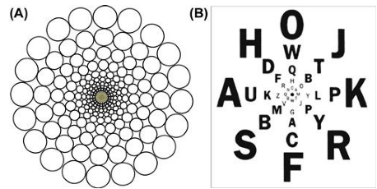
The drop in resolution is dramatic; you are legally blind in the periphery!
Notes:
These figures illustrate the dramatic drop in resolution. People with normal vision resolve several thousand dots within the 2 degree foveal field. Beyond that field, detail fades dramatically (dozens of dots). Outside of foveal field, we are less sensitive to color differences, and most sensitive to motion. This corresponds to a drop from 20/20 to 20/200! But we don’t even notice this! According to Eagleman (quoted in Johnson text), The resolution in your peripheral vision is roughly equivalent to looking through a frosted shower door, and yet you enjoy the illusion of seeing the periphery clearly. … Wherever you cast your eyes appears to be in sharp focus, and therefore you assume the whole visual world is in focus.”

Slide 32
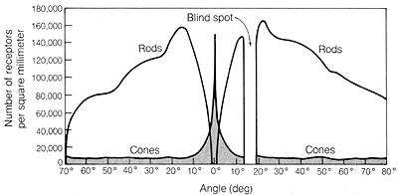
Reason 1:Pixels (cone cells) much denser in fovea
Notes:
Rods: hardly used.
Cones: 158,000/cm**2 in center, 9000/cm**2 everywhere else

Slide 33
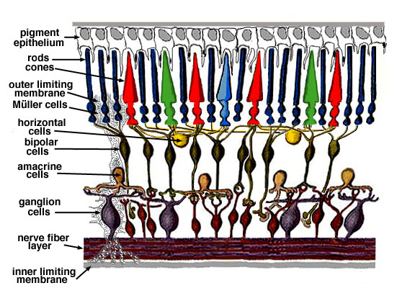
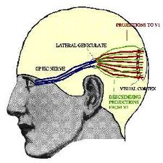
Reason 2: Data from fovea is uncompressed, but data from periphery is
Notes:
1 cone-cell per axon-fiber in fovea
2-3 cone-cells per axon-fiber everywhere else

Slide 34
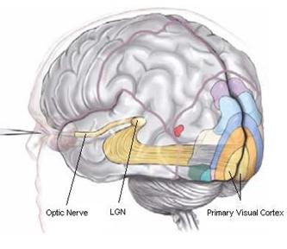
Reason 3: Half of visual cortex serves fovea (1% of retina); other half serves remaining 99%
Notes:
Occipital cortex at back of brain = visual cortex

Slide 35
Why does everything in visual field seem clear, not matter where we look?
Our eyes are constantly scanning the environment, unbeknownst to us
Our brain fills in the details based on those scans and what we expect (interpolation)
In reading task, if text outside of foveal field were dynamically replaced with random text, we wouldn’t notice!

Slide 36
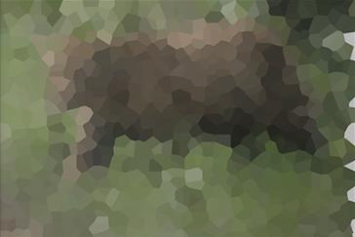
Peripheral vision does aid perception
Provides low-resolution cues to guide eye movements
Good at detecting motion
Improves vision in low-light conditions
Rods take over in low-light vision (“scotopic” vision)
We have more rods in periphery
We see an object better in dark when we don’t look directly at it!
Notes:
Example: if goal is to find flowers, a purple blob on periphery can shift foveal focus

Slide 37
Reading Question #8: Where should error messages be positioned?
In a consistent position on the screen (e.g., a status bar)
Where the error occurs
Where the user is looking when the error occurs
Notes:
C

Slide 38
Reading Question #9: Which of the following can improve visual search time?
Target search items should be consistent with all other items on screen
Target search items should use different color or font
Target search items should move (animate) while other items remain still
B & C
Notes:
D

Slide 39


UI Design Implication: Make error messages visible
Put error where users are looking (in foveal field)
Place the error message near what it refers to
Reserve red for errors (don’t use it for other purposes)
Use error symbol

Slide 40
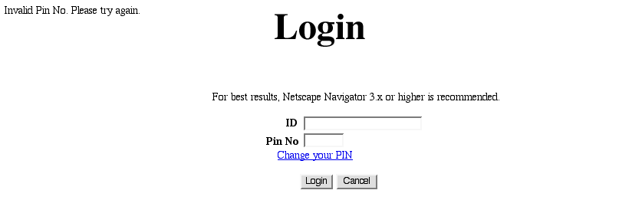
Example: Place error message in foveal field
Move to here!

Slide 41
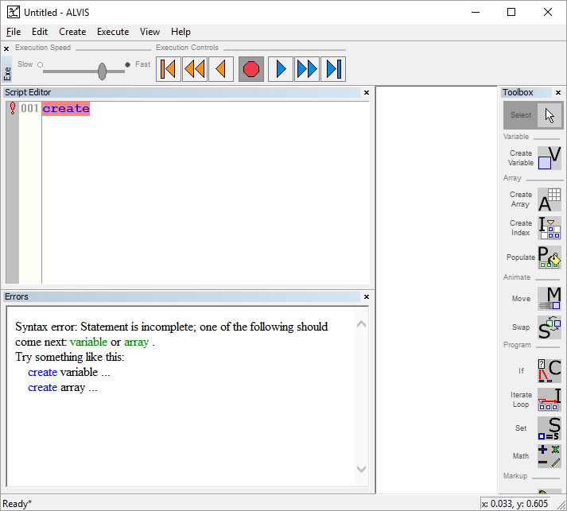
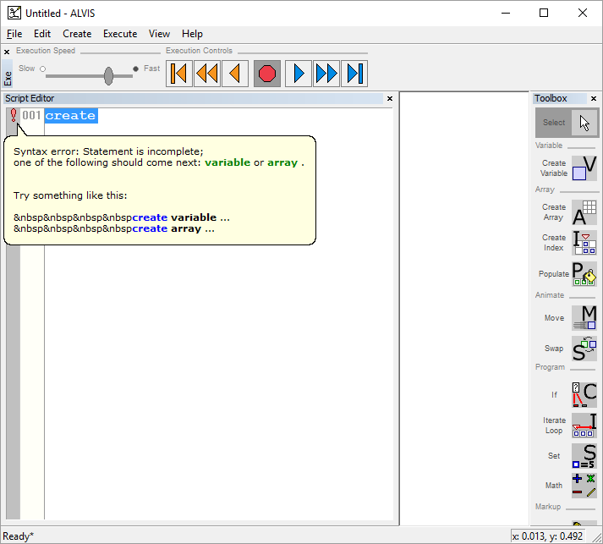
Example: Change ALVIS error window to pop-up tooltip

Slide 42
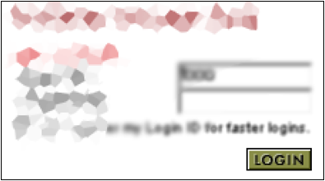

Example: Airborne.com
Will the error message be seen?
Notes:
It’s still on the periphery—remember the fovea is small, just 1-2 cm of screen.
Also, it’s not the only thing in red near the top of the screen; the page title is also red. Hence, when the message appears, we may not notice the change, as, according to our peripheral vision, there’s still something red at top of screen.

Slide 43
Sometimes the “heavy artillery” is necessary (use sparingly)
Popup in error dialog box
Audio: beep
Flash or wiggle briefly (not continuously)

Slide 44
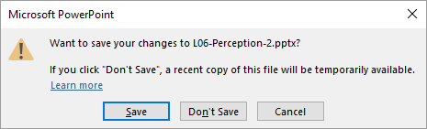
Example: Modal dialog box
Use only in critical situations
Loss of data at stake
Task step cannot be undone

Slide 45
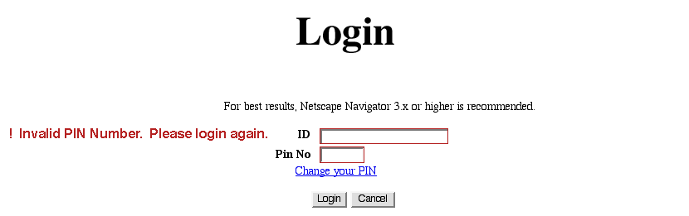
Example: Animated error message
Client internal web-app, improved
Notes:
Improved error msg presentation, to get users attention:
Red
Wiggle
Flash

Slide 46
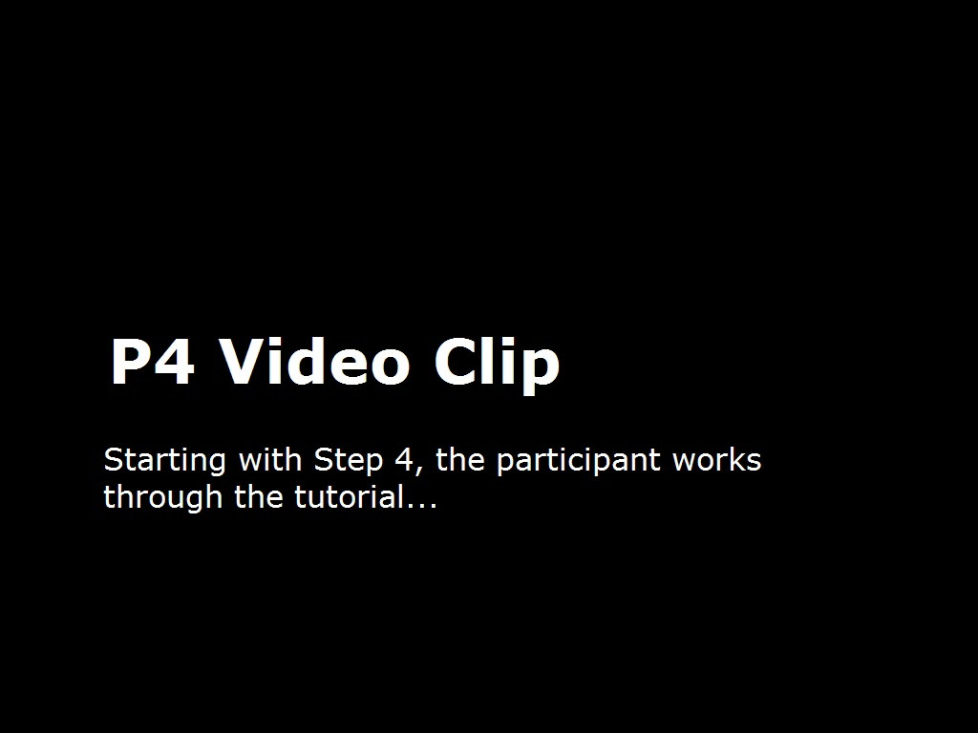
Example: ALVIS “heavy artillery” error feedback (start at 0:39)

Slide 47
Peripheral vision can be exploited to promote efficient visual search
Peripheral vision drives our eyes to focus (the fovea) on items of interest
Movements on the periphery can be reliably detected
Items that stand out (“pop”) in the periphery can be reliably detected
→ Exploiting this fact can reduce search time from O(n) to nearly O(1)!

Slide 48
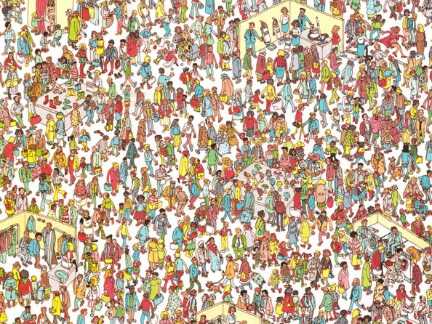
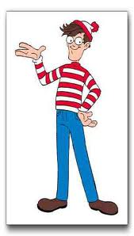
Does target pop out in this display?
Where’s Waldo?
Notes:
Where’s Waldo? Takes careful search to find him.

Slide 49
Find the “Z” in these letters
L Q R B T J P L F B M R W S
F R N Q S P D C H K U T
G T H U J L U 9 J V Y I A
E X C F T Y N H T D O L L 8
G V N G R Y J G Z S T 6 S
3 L C T V B H U S E M U K
W Q E L F G H U Y I K D 9
How fast is the search?
A. O(n) B. Close to O(1) C. Other
Notes:
Find the Z

Slide 50
Find the bold letter in these letters
G T H U J L U 9 J V Y I A
L Q R B T J P L F B M R W S
3 L C T V B H U S E M U K
F R N Q S P D C H K U T
W Q E L F G H B Y I K D 9
G V N G R Y J G Z S T 6 S
E X C F T Y N H T D O L L 8
How fast is the search?
A. O(n) B. Close to O(1) C. Other
Notes:
Find the bold letter

Slide 51
Count the number of “L”s in these letters
L Q R B T J P L F B M R W S
F R N Q S P D C H K U T
G T H U J L U 9 J V Y I A
E X C F T Y N H T D O L L 8
3 L C T V B H U S E M U K
G V N G R Y J G Z S T 6 S
W Q E L F G H U Y I K D 9
How fast is the search?
A. O(n) B. Close to O(1) C. Other
Notes:
Count # of Ls: 7

Slide 52
Count the number of blue symbols
W Q E L F G H U Y I K D 9
F R N Q S P D C H K U T
3 L C T V B H U S E M U K
G T H U J L U 9 J V Y I A
L Q R B T J P L F B M R W S
E X C F T Y N H T D O L L 8
G V N G R Y J G Z S T 6 S
How fast is this search?
A. O(n) B. Close to O(1) C. Other
Notes:
Count # of blue symbols

Slide 53
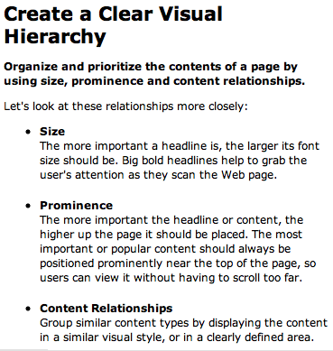
Find the “Prominence” header
• Prominence

Slide 54
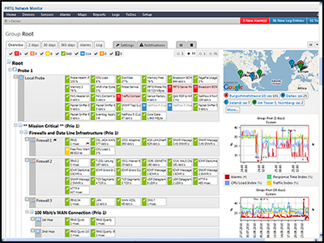
Find the faulty servers

Slide 55
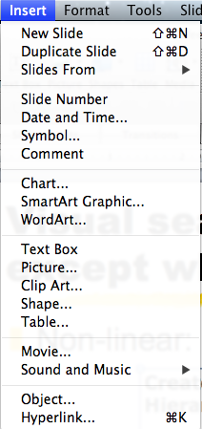
Find an unfamiliar menu item
With experience, people learn item-positions, so search becomes non-linear (be consistent!)
Notes:
This contrasts with other examples, in that consistency will improve this kind of visual search.

Slide 56
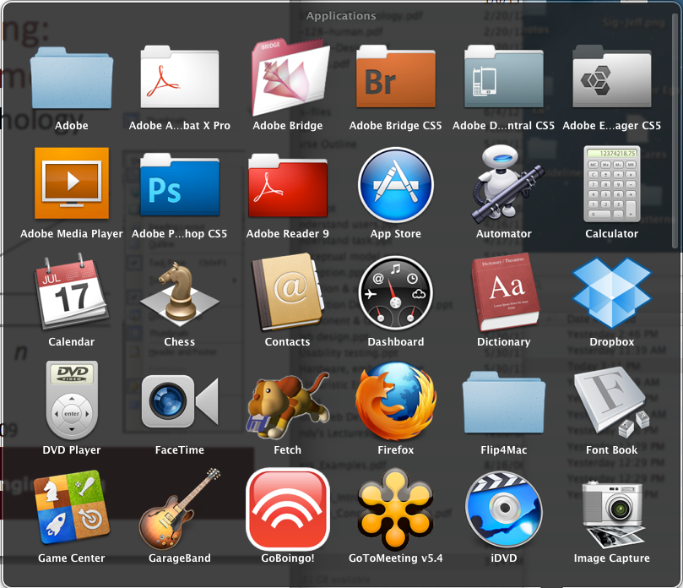
Find GarageBand
Notes:
This display combines alphabetical order with some pop-out of items. Familiarity with icons can aid search here.

Slide 57
This Class is About How Human Perception and Reading Work (Johnson 4-6)
Key topics/questions for Today’s Class
Our color vision is limited
Our peripheral vision is poor
Reading is unnatural
IA#3: Apply what you have learned to a design challenge

Slide 58
Reading Question 10: Human brains are pre-wired to read
True
False
Notes:
B

Slide 59
Reading Question 11: Reading is…
Feature-driven
Context-driven
A & B
Notes:
C

Slide 60
Reading Question 12: User interfaces should…
Use text judiciously to explain how to do things and to explain choices users have
Use repetitive textual descriptions so that users are not forced to memorize things as they make choices
Try to minimize the amount of text and maximize distinctions between blocks of text
More than one of the above
Notes:
C

Slide 61

Reading is Unnatural
We’re pre-wired for (spoken) language
Brain learns language easily in childhood
Nearly everyone learns a language
We are not pre-wired for reading
Brain has no special facility for reading
Learning reading is like learning other skills: Writing, arithmetic, music, (Same brain areas mediate)
Many people never learn to read well, or at all

Slide 62
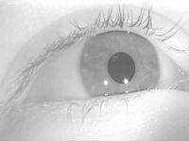
How we read
Fovea and perifovea (just outside fovea) are only areas trained to read
Thus, we must move our eyes a lot (each saccade is 0.1 second)
Saccades “fire” based on goals, events in periphery, events detected by other perceptual senses, and past history
When reading, must saccades jump forward, but about 10% jump backward
https://en.wikipedia.org/wiki/Saccade

Slide 63
Animation of how we read
Four score and seven years ago, our forefathers brought forth on this continent a new nation, conceived in liberty…

Slide 64
Reading is both top-down and bottom-up
Feature-driven (bottom-up) reading entails recognizing basic features (lines, edges, etc.), which we learn to put together into letters and words
Context-driven (top-down) reading entails recognizing high-level patterns (e.g. common sentence patterns) and guessing specific components of patterns

Slide 65
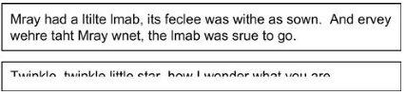
Can you read these examples?
Notes:
Example of top-down (context-driven) reading

Slide 66
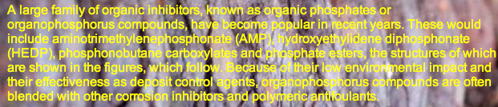
Unfamiliar words, difficult typefaces, and poor contrast can disrupt reading
Unfamiliar words:
Bailiwick, penultimate, heretofore, defragment
Difficult typefaces
TEXT IN ALL CAPS, ESPECIALLY IN A FANCY FONT
Centered text
Patterned background or poor contrast
Notes:
Studies show uppercase read 10-15% more slowly than normal text! This is likely due to lack of practice

Slide 67
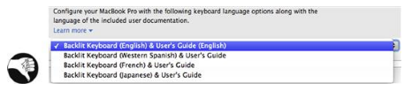
Text buried in repetition can disrupt reading
English
Western Spanish
French
Japanese
Notes:
Studies show uppercase read 10-15% more slowly than normal text! This is likely due to lack of practice

Slide 68
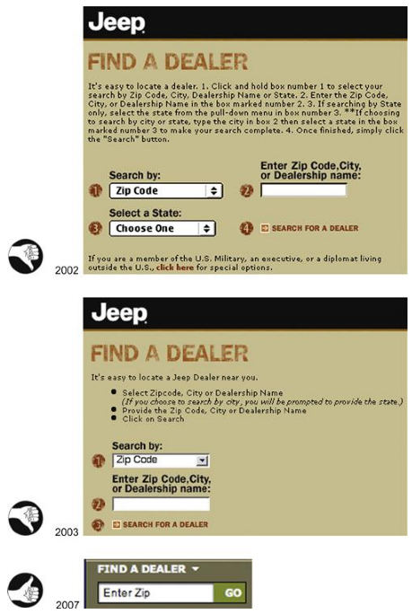
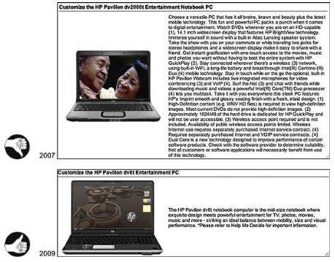
Don’t make users read too much text!

Slide 69
This Class is About How Human Perception and Reading Work (Johnson 4-6)
Key topics/questions for Today’s Class
Our color vision is limited
Our peripheral vision is poor
Reading is unnatural
IA#3: Apply what you have learned to a design challenge

Slide 70
Many new principles can be extracted from Johnson 1-6
Ch. 1: Human perception is biased
Avoid ambiguity in information displays
Be consistent
Understand users’ goals
Ch. 2: Human perception optimized to see structure
Gestalt principles
Ch. 3: Humans seek and use visual structure
Impose visual structure on information displays
Ch. 4: Color vision is limited
Use color redundantly with other cues
Make sure colors are distinguishable, even for colorblind
Ch. 5: Peripheral vision is poor
Use a combination of movement, color, different font to make things stand out in periphery and optimize visual search
Ch. 6: Reading is unnatural
Avoid unfamiliar words, difficult fonts, poorly contrasting backgrounds
Minimize text in interfaces

Slide 71
These complement Norman’s principles
Affordances/signifiers
Constraints
Mappings
Feedback
Conceptual models
Visibility

Slide 72
In IA#4, apply these to the design of a UI for a “Swimmer’s Helper”
Assignment description is available under IA #4 on OSBLE
First set of sketches will be due next Tuesday, Feb. 7 at beginning of class
Some of you will get to present preliminary designs to class next Tuesday for feedback and discussion (“design crits”)
Some of next Tuesday’s class will be a “design studio” in which you will work further on your designs

Slide 73
To do between now and next class
Work on first draft of IA #4 (due next Tuesday)
Read Johnson Ch. 10-12

